Slide 1
Greetings
Prof. (Dr.) M. K. Bhandari
E mail: profmkb.law@gmail.com

Slide 2
Legal Research and Methodology Formulating Research Design
Research Meaning
Encyclopaedia Britannica
- Trained Scientific Investigation
- To go round in circle
- Discovery of Truth
- Original and First hand study of authorities
or experiments

Slide 3
- First Research Rule :
- What is wanted is sound, publishable
research, not attainable perfection.
Second Rule
- Honest and dispassionate investigation

Slide 4
Third Rule
Legal Research should not, of course be
confined to books, articles, treaties, statures
and cases, but if necessary should be
interdisciplinary

Slide 5
Methodology
Broader term and its scope is wider than
methods.
Characteristics of methods, the principles on which method operate and standards governing the selection and application – Judy Payne

Slide 6
Formulation of Research Problem Sources to be used in Selection of Topic
Books, Reports, Journals, Research Papers Prior Research Works & Related Legal Literature
Significant Court Rulings.
Available Data
Ongoing Research
Media Reports

Slide 7
Basic Consideration
Involve Researchable Problem
Feasibility
Legal, Juristic, academic and socio economic value
Practical Consideration
Understanding of Scholar
Narrowing down of topic

Slide 8
Research Design / Synopsis / Research Proposal
Doctrinal – Qualitative
Non Doctrinal – Empirical - Quantitative
Historical
Comparative
Inter - Disciplinary

Slide 9
Title of Research Project
Self Explanatory
Clear – No Ambiguity
Short
2. Introduction
Nature of Research Problem

Slide 10
3. Hypothesis
A hypothesis is an unproven proposition or possible solution to a problem.
William Zikmund
Tentative answer to Research Problem
Chava & David

Slide 11
4. Review of Literature
5. Objective of Study
6. Research Methodology
7. Contents/Chapter Scheme
8. Significance and Likely Contribution
9. Tables and Bibliography
---------------

Slide 12
2. Tools of Data Collection & its Analysis
Qualitative – Research
Quantitative – Research
For Empirical / Non – Doctrinal Research data collection assume great significance
Primary Source
Secondary Source

Slide 13
Tools of Data Collection
Survey Method – Sampling Technique
Case Study
Questionnaire
Interview

Slide 14
Sampling Technique
Sample Design
Source
Simple Random
Systematic
Cluster
Quota
Snowball

Slide 15
Sampling Error
Sample Size
--------------------

Slide 16
Data Analysis
Data Reduction – Summarized and Re-arranged
Editing – To Check Accuracy
Coding
Entry

Slide 17
Analysis
Process of examining, summarising and
drawing conclusion from the collected data

Slide 18
Computer Software Packages
SPSS (Statistical package for Social Science)
SPSS / PC + - Student Software, Menu Driven and Easy to use.
----------------------

Slide 19
3. Data Processing and Interpretation
Almost last stage of Investigation
Subjectivity of Investigator
Nature of Subject Matter
Socio-Economic, Political Philosophy
Influence of Vested Interest

Slide 20
1. Object
According to Kerlinger
Interpretation takes the result of analysis,
makes inferences pertinent to research
relations studies and draws conclusion about
these relations

Slide 21
Interpretation can be both
Descriptive
Graphical
Charts
Tables
Diagrams

Slide 22
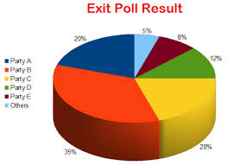

Slide 23
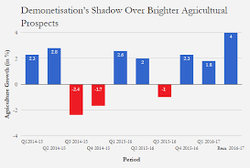

Slide 24
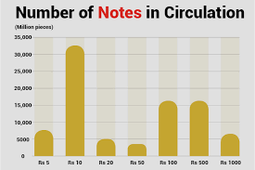

Slide 25
Cause and Effect Relationship
Easy in Case of Quantitative
Difficult in Case of Qualitative
-------------------------

Slide 26
References
Indian Law Institute (ILI) – Legal Research and Methodology (Ed. S.K. Verma & M. Afzal Wani) (2010)
Anwar Yagin – Legal Research and Writing Methods. Lexis – Nexis (2008)
Dr. M.K. Bhandari – Data Collection : Tools and Techniques. I.J.L.S (1988)
N.R. Madhava Menon – Clinical Legal Education (Eastern Book Company) (2011)
NLSUI Bangalore & NLU – Delhi Publications on Citation Methods and legal writings

Slide 27
THANKS

